Slide 1
JPG GRAYSCALE IMAGE EDGE DETECTION
Team Member: Haobo Chen
Ni Kang
Haoming Zhang
TA: Reena Elangovan
1
Notes:
Ni Kang

Slide 2
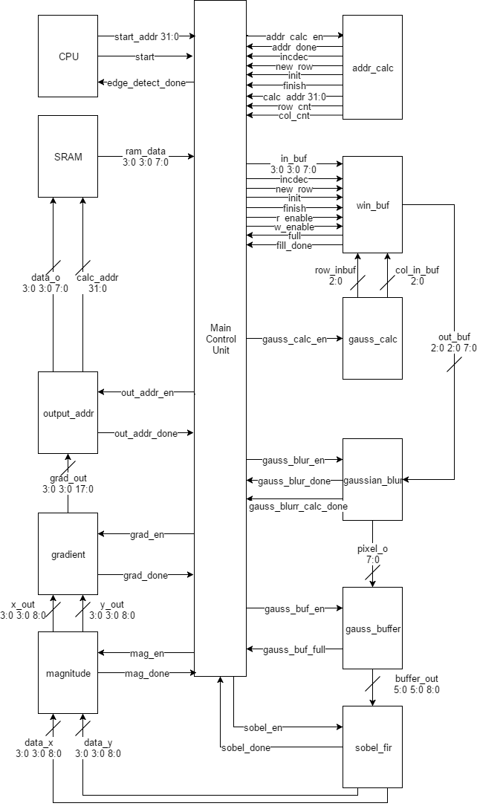
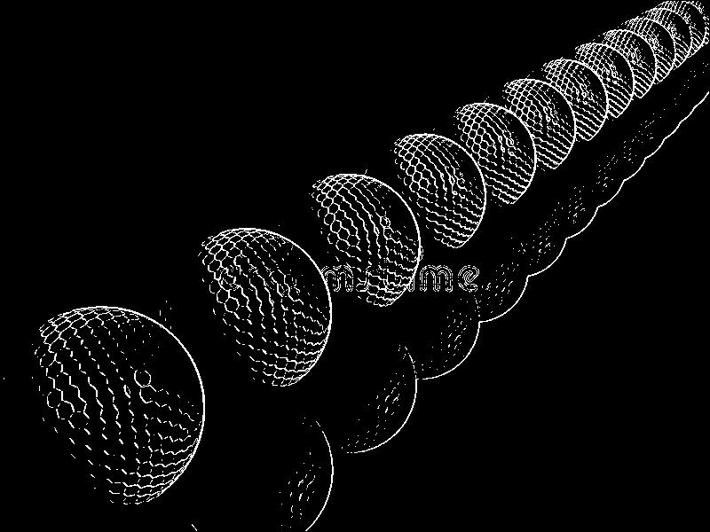
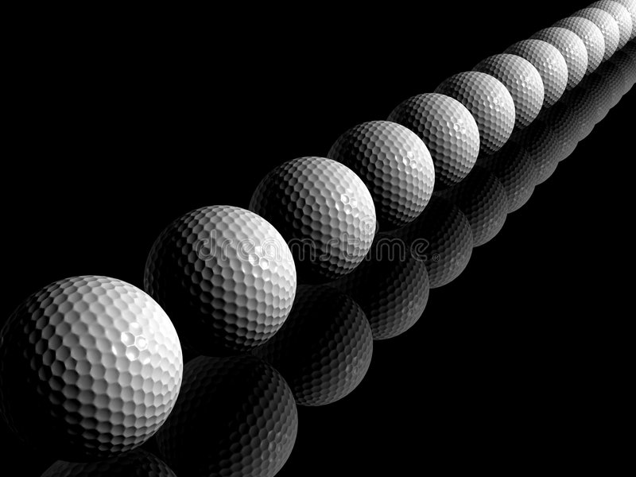

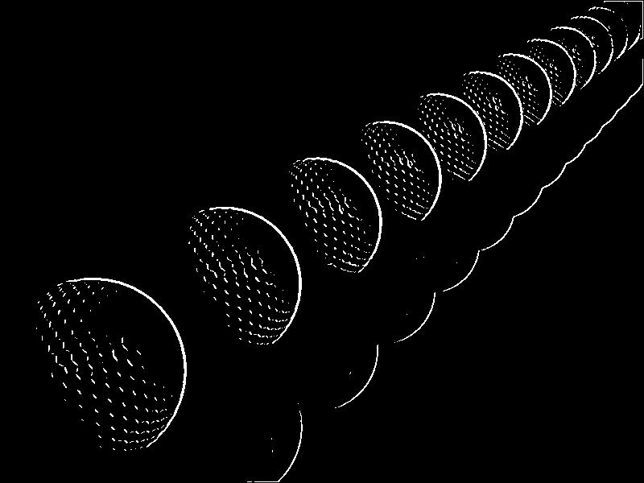
Design Overview
edge detect result without gaussian blur
source image
image after gaussian blur
edge detect result with gaussian blur
Edge detector function
Gaussian Blur is necessary
Edge detector is a good fit for ASIC design
2
Notes:
Haobo Chen
Edge detection is a useful system that have common use in our lives. For example, text recognition and face recognition. Given any image, it is able to output an image with only the majors edges. In the case of text recognition, this system can help to extract text information from images. We took advantage of the sobel filter method to implement our design. But before the image is processed by the Sobel filter, it is necessary to preprocess it with a gaussian blur filter. As you can see in the example output we generated by python, the result image without the gaussian blur recognized the watermark, which is not what we want. In our design, there is a main control unit that is responsible for the top level workflow. In general, every block is enabled only when the block before it is done. The image will first be read into the SRAM, and the address calculation module will calculate the address so that SRAM can provide the correct data. A 8 by 8 chunk will then be stored in the window buffer module. Then the following three gaussian modules will preprocess the 8 by 8 chunk and store a 6 by 6 blurred result into the gaussian buffer. Once the gaussian buffer is full, sobel filter is enabled and will feed two 4 by 4 matrices to magnitude module which basically takes the absolute value of the matrix. Then the gradient calculation module will calculate the value of color gradient for comparison. Finally, the output address module will compare the value calculated by gradient module with a threshold that we define and calculate the correct address for writing data. The edge detector is a good fit for ASIC design because it requires repetitive calculation and doesn’t need a lot of modification on the design when reusing it.

Slide 3
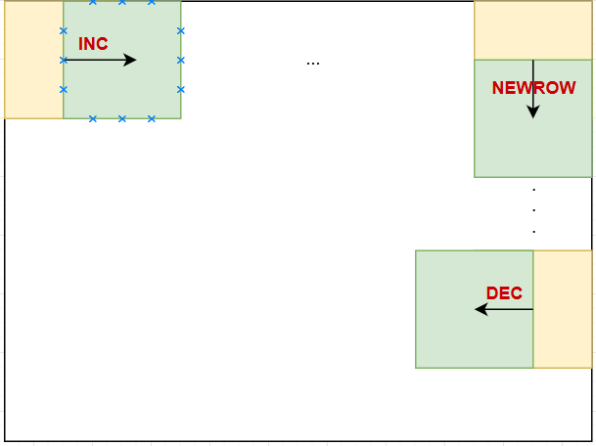
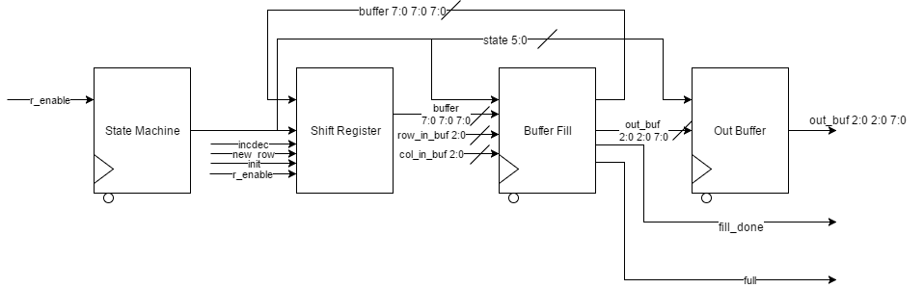
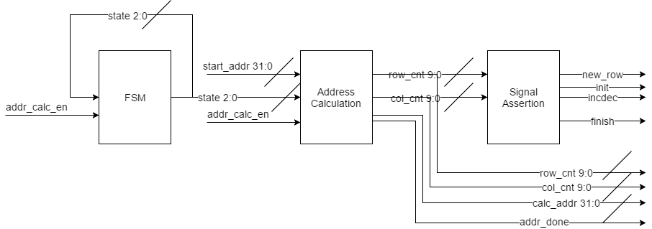
Address Calculation and Window Buffer
Address Calculation module functionality
Window Buffer operation
3
Notes:
Haobo Chen
Now I will discuss the function of address calculation module and window buffer module in detail. The window buffer iterates in a zigzaging manner. But addr_calc module is controlling the iteration. The addr_calc will calculate the current address for reading based on the current row and column count. It will also decide where the window buffer is moving towards by keeping track of the location of the window buffer. The init signal will be asserted during the initialization phase of the implementation. The incdec signal indicates whether the window buffer is going to the left or right. The new_row signal is asserted only when the window buffer hits an edge of the image. Everytime when addr_calc finishes, the addr_calc_done signal will be asserted and MCU will enable the window buffer. The 8 by 8 window buffer is divided into 16 sections so that the read size would be a 32bit word. During the initialization phase, all 16 sections will be filled. Otherwise, in the general case, the buffer will shift the existing data to a direction specified by the signals sent from addr_calc, then fill in the according 8 sections. Every time a filling process is done, the fill_done signal will be asserted to start the next fill. Once the window buffer is full, it will assert the full signal and wait for gaussian blur to enable it’s w_enable. When w_enable is asserted, the 3 by 3 output buffer at the coordinate decided by row_in_buf and col_in_buf will be filled accordingly. The detail will be discussed in the result session.

Slide 4
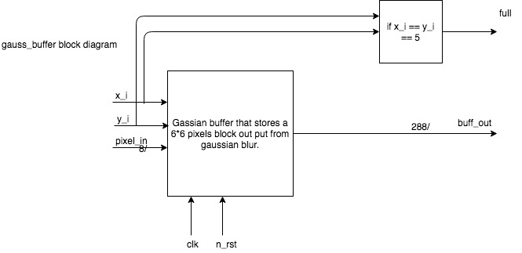
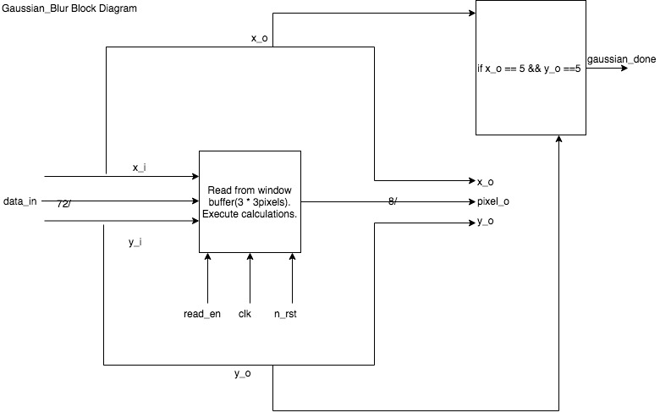
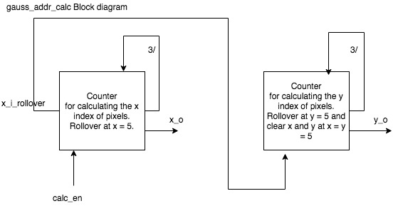
Gaussian Blur Function blocks
Gaussian address calculation block
Gaussian blur calculation block
Gaussian buffer block
4
Notes:
Haoming Zhang

Slide 5
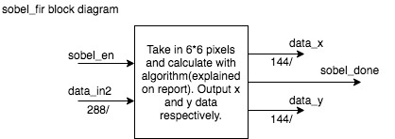
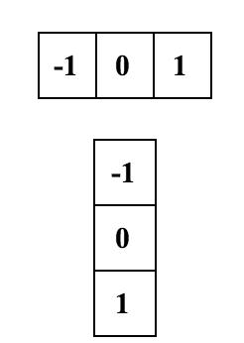
Sobel Filter Function Block
5
Notes:
Haoming Zhang

Slide 6
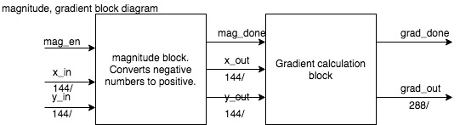
Magnitude and Gradient Block
6
Notes:
Ni Kang

Slide 7
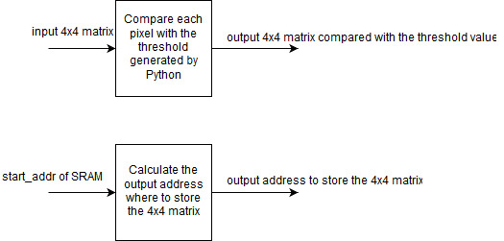
Output Address Block
7

Slide 8
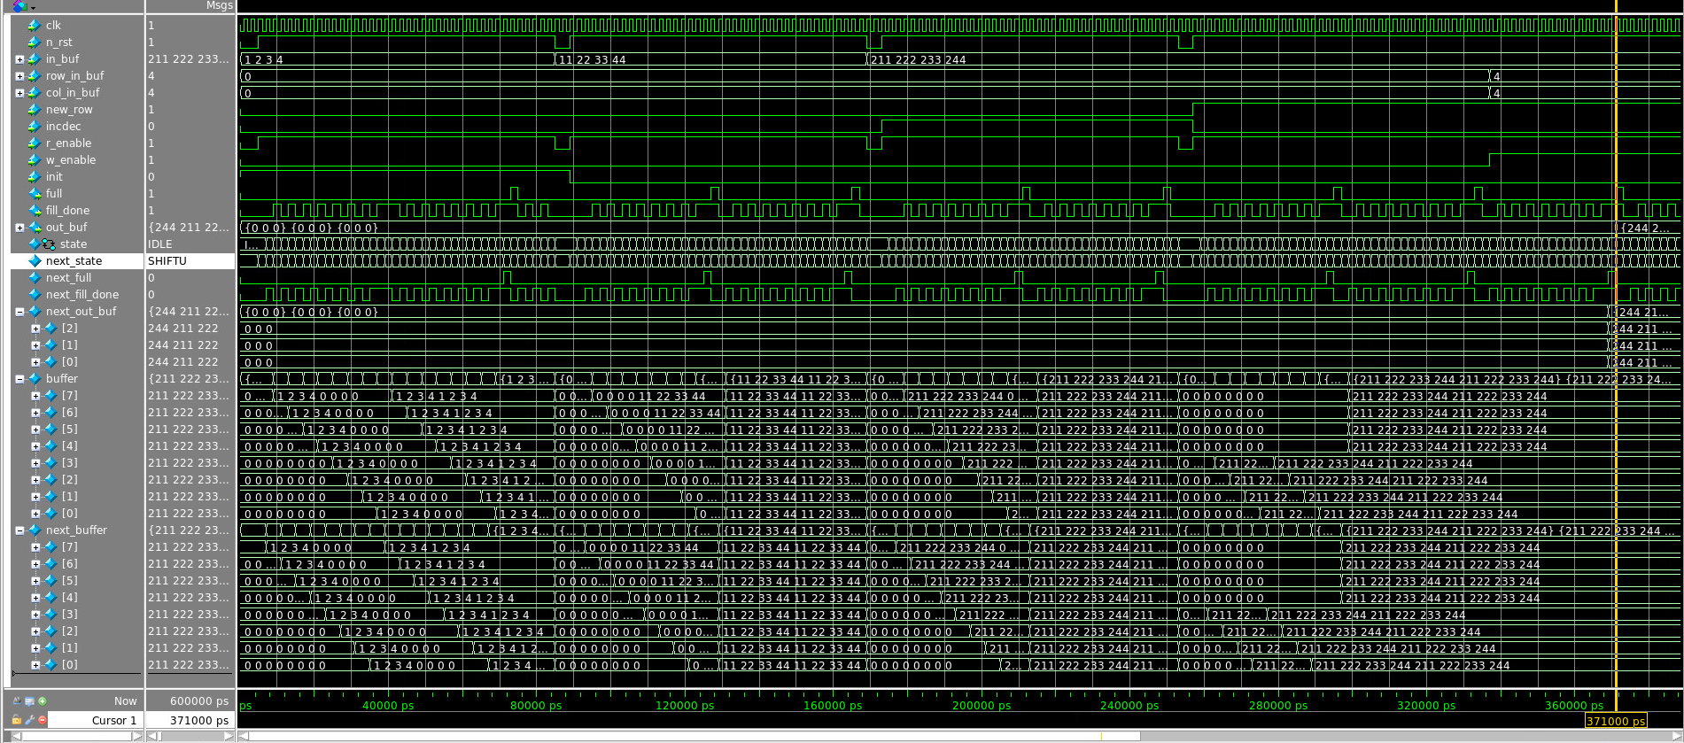
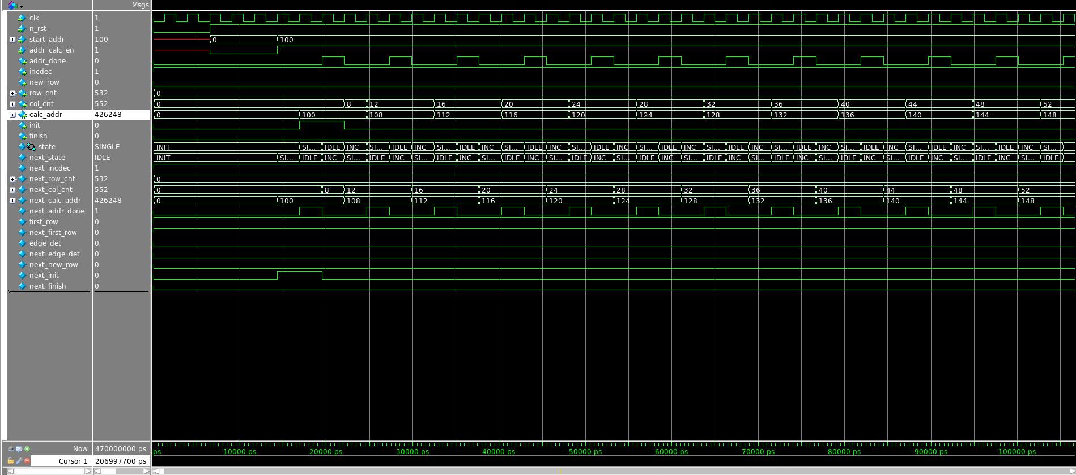
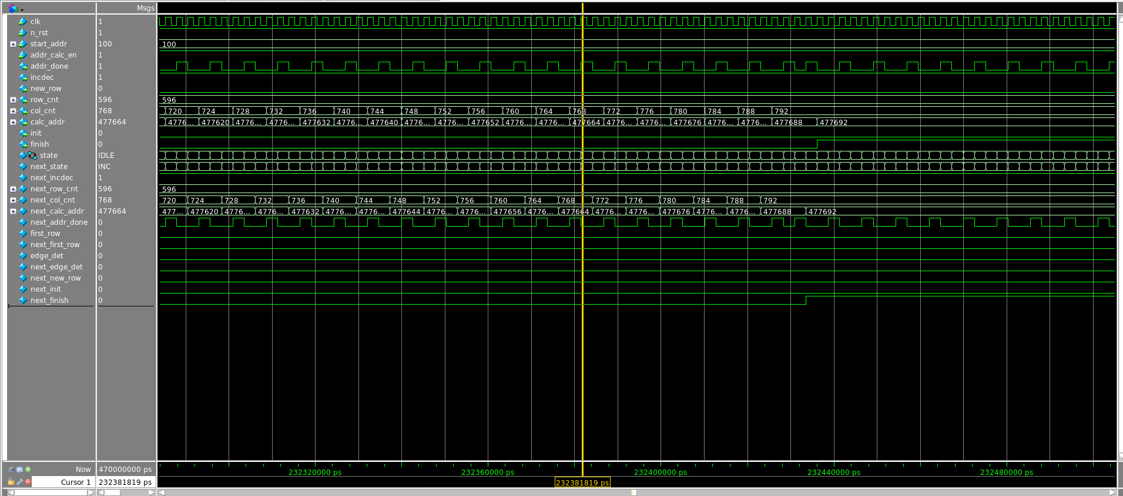
Address Calculation and Window Buffer Results
1, 2, 3, 4, 0, 0, 0, 0
0, 0, 0, 0, 0, 0, 0, 0
0, 0, 0, 0, 0, 0, 0, 0
0, 0, 0, 0, 0, 0, 0, 0
0, 0, 0, 0, 0, 0, 0, 0
0, 0, 0, 0, 0, 0, 0, 0
0, 0, 0, 0, 0, 0, 0, 0
0, 0, 0, 0, 0, 0, 0, 0
1, 2, 3, 4, 0, 0, 0, 0
1, 2, 3, 4, 0, 0, 0, 0
0, 0, 0, 0, 0, 0, 0, 0
0, 0, 0, 0, 0, 0, 0, 0
0, 0, 0, 0, 0, 0, 0, 0
0, 0, 0, 0, 0, 0, 0, 0
0, 0, 0, 0, 0, 0, 0, 0
0, 0, 0, 0, 0, 0, 0, 0
1, 2, 3, 4, 0, 0, 0, 0
1, 2, 3, 4, 0, 0, 0, 0
1, 2, 3, 4, 0, 0, 0, 0
0, 0, 0, 0, 0, 0, 0, 0
0, 0, 0, 0, 0, 0, 0, 0
0, 0, 0, 0, 0, 0, 0, 0
0, 0, 0, 0, 0, 0, 0, 0
0, 0, 0, 0, 0, 0, 0, 0
1, 2, 3, 4, 1, 2, 3, 4
1, 2, 3, 4, 1, 2, 3, 4
1, 2, 3, 4, 1, 2, 3, 4
1, 2, 3, 4, 1, 2, 3, 4
1, 2, 3, 4, 1, 2, 3, 4
1, 2, 3, 4, 1, 2, 3, 4
1, 2, 3, 4, 1, 2, 3, 4
1, 2, 3, 4, 1, 2, 3, 4
0, 0, 0, 0, 0, 0, 0, 0
0, 0, 0, 0, 0, 0, 0, 0
0, 0, 0, 0, 0, 0, 0, 0
0, 0, 0, 0, 0, 0, 0, 0
0, 0, 0, 0, 0, 0, 0, 0
0, 0, 0, 0, 0, 0, 0, 0
0, 0, 0, 0, 0, 0, 0, 0
0, 0, 0, 0, 0, 0, 0, 0
8
Notes:
Haobo Chen
Here is the resulting waveform of addr_calc module. This is the init phase of the module, as we can see, the init signal is asserted only for the first time the block is implemented. col_cnt increase by a step 4 every time except for the first time. The address is calculated accordingly. Every time the counters are incremented, the addr_calc done is asserted.
This is the ending phase of the module. As we can see, when the counters reaches the end of the image. The finish signal is asserted. This signal will be sent to the external system to indicate that the entire edge detection is finished.
Now I will discuss the window buffer results. Here is the waveform for the window buffer. There are 5 test cases. The first one is the init case. As we can see, the 16 sections are filled one by one until the buffer is full. the next three cases are the normal cases when the buffer is going right, left and down. In these cases, the buffer will first shift the data and then fill in new datas. The last case is when the w_enable is asserted, as we can see, the output buffer is filled with the data at coordinate (4, 4)

Slide 9
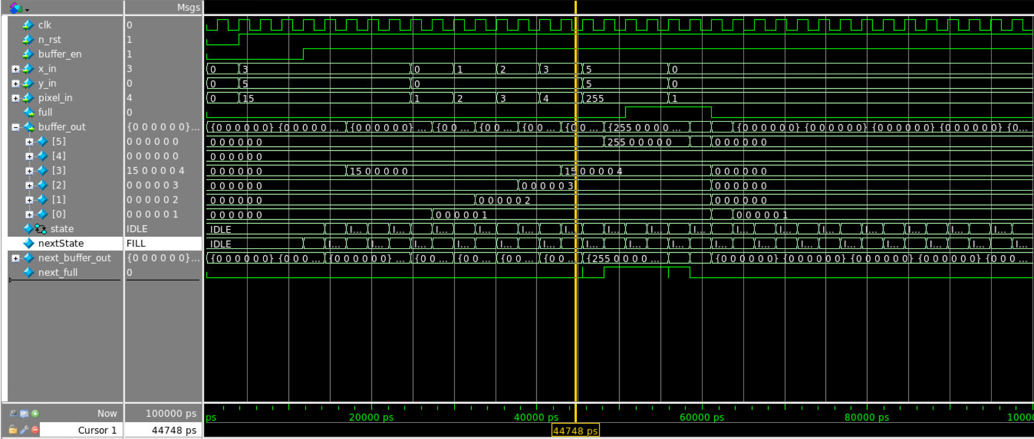
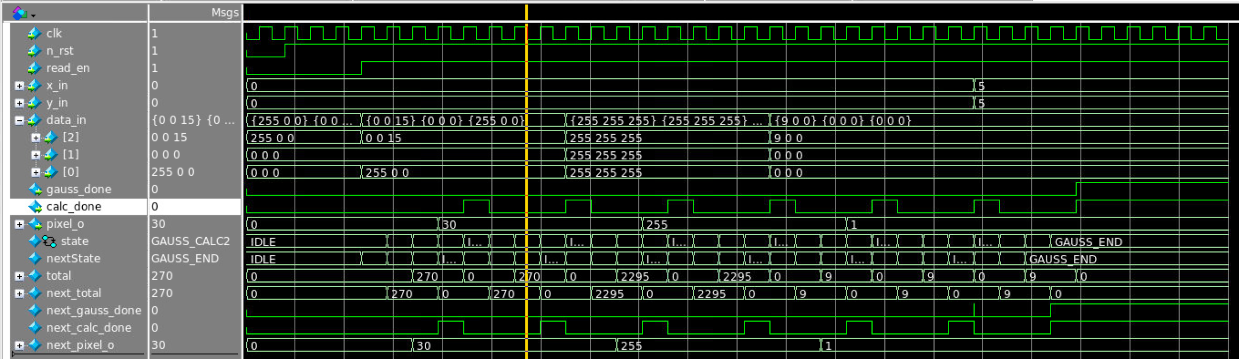
Gaussian Blur waveforms
x = 3, y = 0
pixel_in = 4
0 0 15
0 0 0
255 0 0
0 0 0 0 0 0
0 0 0 0 0 0
15 0 0 0 0 4
0 0 0 0 0 3
0 0 0 0 0 2
0 0 0 0 0 1
270 / 9 = 30
9
Notes:
Haoming Zhang

Slide 10
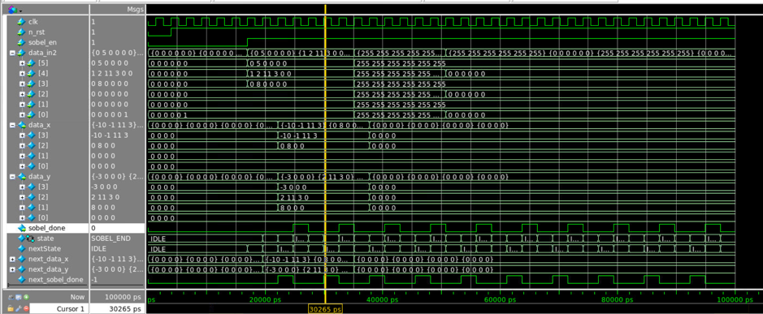
Sobel filter waveform
0 5 0 0 0 0
1 2 11 3 0 0
0 8 0 0 0 0
0 0 0 0 0 0
0 0 0 0 0 0
0 0 0 0 1 0
-10 -1 11 3
0 8 0 0
0 0 0 0
0 0 0 0
-3 0 0 0
2 11 3 0
8 0 0 0
0 0 0 0
10
Notes:
Haoming Zhang

Slide 11
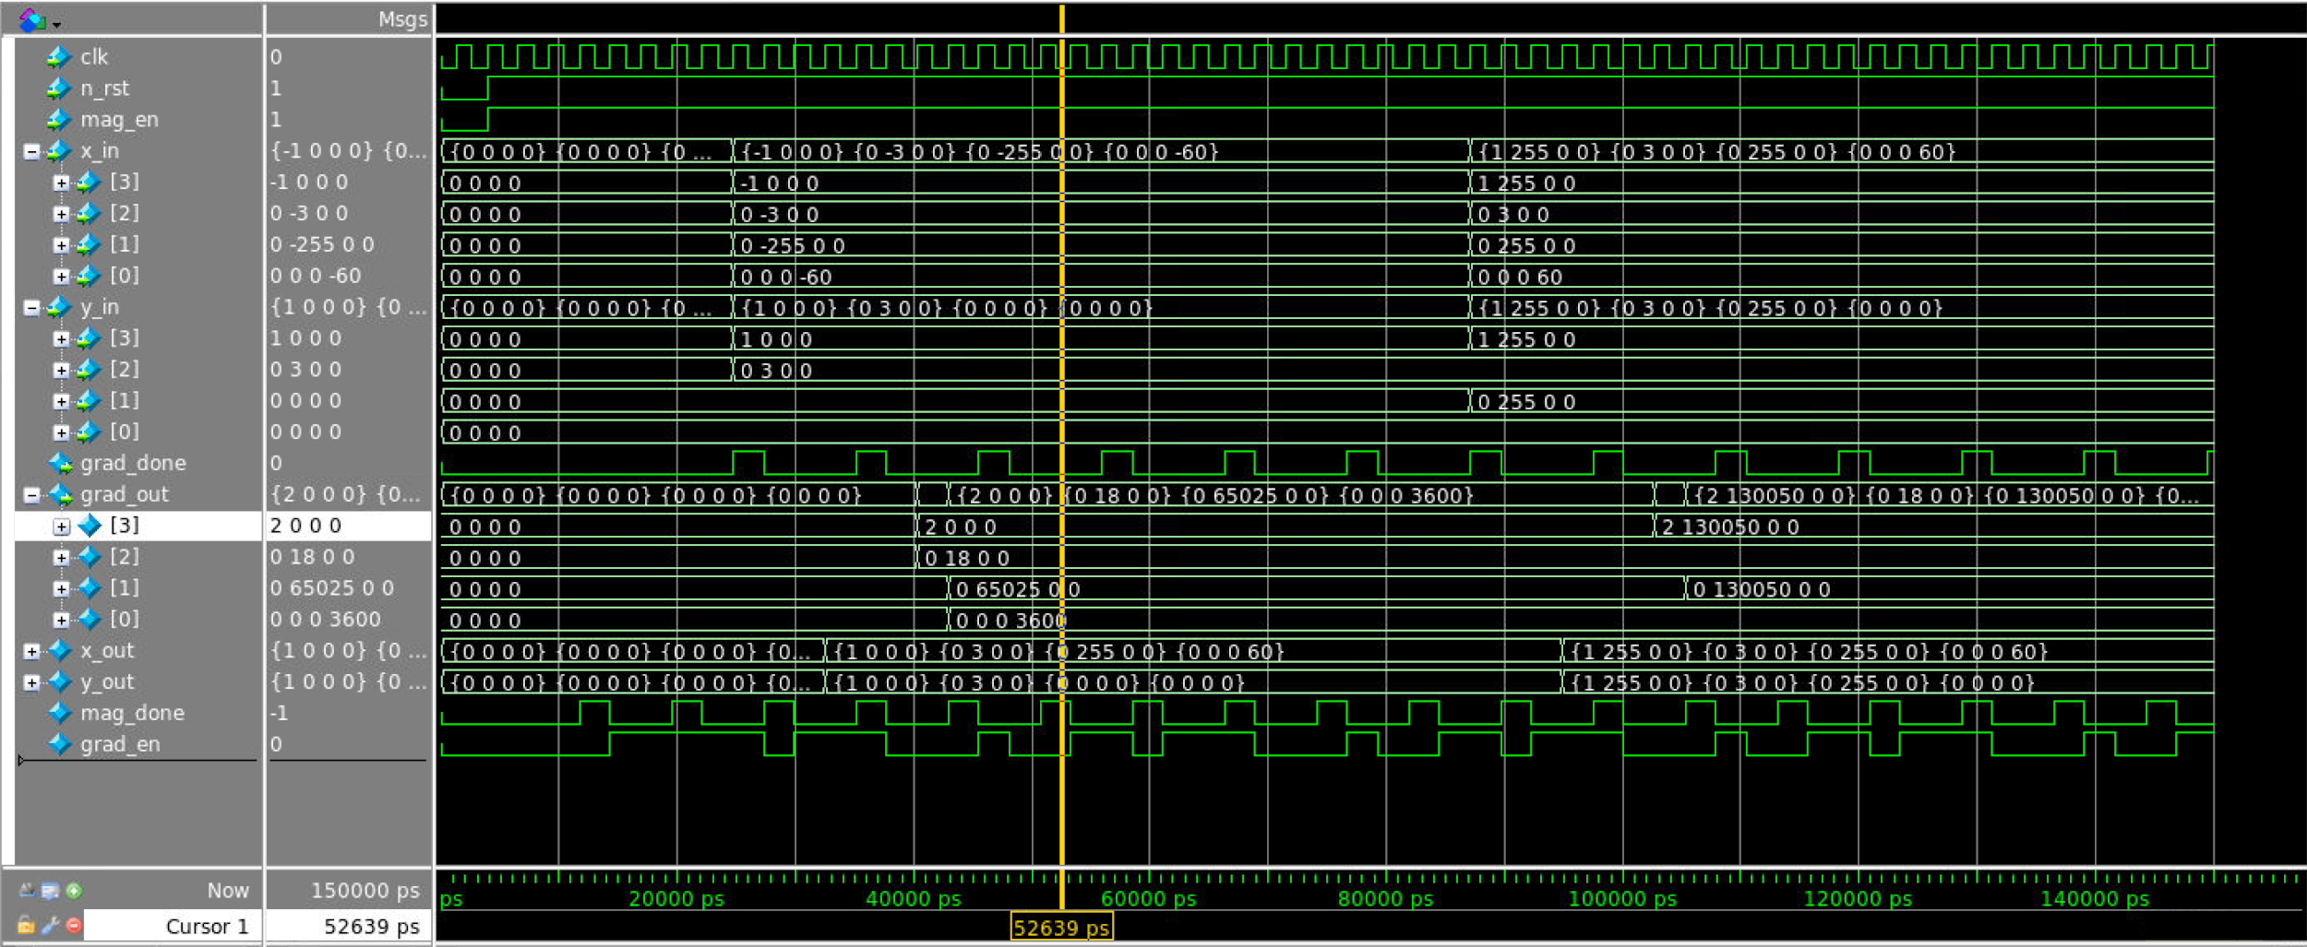
Magnitude and Gradient Waveform
-1 0 0 0 1 0 0 0
0 -3 0 0 0 3 0 0
0 -255 0 0 0 0 0 0
0 0 0 -60 0 0 0 0
2 0 0 0
0 18 0 0
0 65025 0 0
0 0 0 3600
11
Notes:
Ni Kang

Slide 12
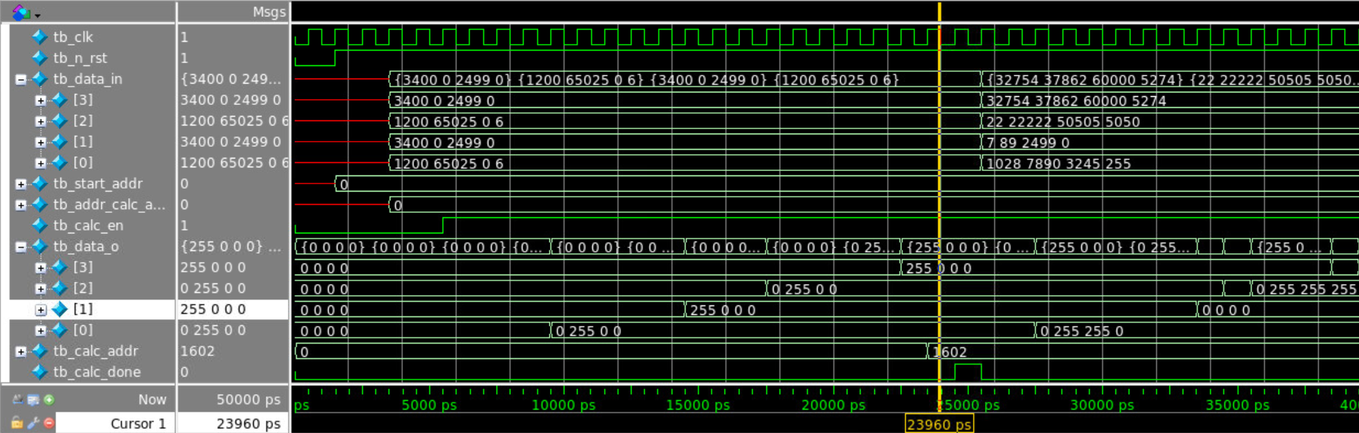
Output Address Waveform
3400 0 2499 0
1200 65025 0 6
3400 0 2499 0
1200 65025 0 6
255 0 0 0
0 255 0 0
255 0 0 0
0 255 0 0
12
Notes:
Ni Kang

Slide 13
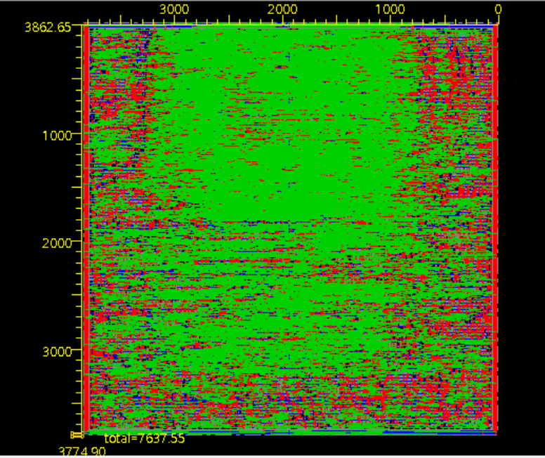
Layout of the Design
13
Notes:
Ni Kang
Area and Timing

Slide 14
Conclusion
Challenge
If we do it over again, …
Improvement
14
Notes:
Ni Kang
Challenge:
Input image data
handshake and interface between each block
pipelining is difficult when we tried to figure out our Main Control Unit
If we do it over again, what approach to take to do it differently:
shrink the size of window buffer. Decrease the amount of data to be process each time in each one of our blocks.
Do the pipelining in order to increase the speed.
Improvement:
First one is definitely pipelining.
Change the image to RGB instead of grayscale.
Can process image with different sizes instead of fixed size.

